Slide 1
Ethertype 886 from the Intel website
Probe Packets and Settings
AFT and ALB teams use probe packets. Probes are packets (type 886D, either multicast or broadcast) passed over the network between team members to allow the ANS software to test the member's status. They do add a minor amount of traffic to the network and should be turned off in near capacity networks.
Note: In NetWare*, ANS probes are turned off by default when only Ethernet_802.2 and/or Ethernet_802.3 frame types are in use. This is due to the fact that Ethernet_802.2 and Ethernet_802.3 frame types may not allow ANS probes to be sent correctly and may cause one or more adapters to failover unnecessarily. If you intend to use the probe feature of ANS, Intel recommends that you load the frame types Ethernet_II or Ethernet_Snap. (You do not need to bind any protocols to these frame types.)
Note: While the other modes do not require probe packets because the switch is an integral part of the team setup, there may be packets passing between the switch and the team for administration purposes.
Probe Settings:
* Probe (ProbeEnable) - Provides the capability to turn probe packets on or off.
* Packet Type - broadcast or multicast
* CheckTime - sets the time to wait for a probe.
* Max Number of Probe Retries - number of times the probe is resent without answer before setting the non responding adapter to disabled.
* ProbeSendTime (only some OS) - length of time between probe sends. Based on the tick_frequency. Example, if tick_frequency is 50 milliseconds and the probe interval is 1 second, then ProbeSendTime is 20.
Note: Changing any of these Advanced Settings also changes the amount of time for failover.

Slide 2
Ethertype 886 from the Intel website
Mechanism of the Probe for determining valid team members and primary adapter.
At each 'probe interval', EACH adapter in the team sends a probe packet to ALL other adapters in the team. (The probe destination address is a multicast address which has been downloaded to the underlying member adapters during initialization - so only one packet is sent). These packets will be forwarded across the PCI bus to the upper layers, but will only be received by adapters registered with this address. In addition, probe packets will not be passed through unregistered routers or any router that is blocking the packet type (commonly done with broadcast packets).
If probe sends are enabled:
* Probe packets are sent periodically by all adapters in the team at the same time (after the ProbeSendTime interval). These probes are sent to other adapters in the team using broadcast/ multicast probes.
* If an adapter fails to send or report receiving valid probes after the set timeout period, it is marked disabled. If it is the primary adapter, that role will failover to the secondary adapter.
* If the probe packets don't reach their destination before the ProbeCheckTimeout, retries may be used before disabling the destination adapter. (ProbeMaxRetryCount).
Adapters that are not in the primary nor secondary roles may be marked disabled without any need for roles changing. But if a primary or secondary adapter is marked disabled, a failover is required. The check for a better adapter is made once during each fail-over cycle. Settings or conditions may apply that make an adapter other than the current primary the best adapter for the primary role. (Enabled adapters are obviously preferred over a disabled adapter.)
Note: If the base driver is resetting, the probe sends do not succeed causing an immediate fail-over.
Other Failover Detection Methods
Probes might be turned off for multiple reasons:
* To avoid repeated failovers caused by too much network latency,
* To minimize network traffic, or
* Because of a router or other device blocking broadcasts or this packet type.
With Probes off, there are two other methods by which team member state is monitored:
* Link-Based - Monitoring actual link to partner port per adapter.
* Activity-Based - Monitoring activity on the wire to determine which has the most traffic.

Slide 3
Ethertype 886 from the Intel website
Failback and the Role of the Preferred Primary
Failback refers to the return of the primary role to the set Preferred Primary adapter when said adapter returns to active status after failover has occurred. Failback will only occur when the Preferred Primary adapter is manually set. If the Primary is set by software, failback will not occur.
Additional Advanced Settings for Teaming
* Load Balance Refresh Rate/Balance Interval - The interval between software checks of current load balance and determination of rebalance.
* Number RX packets/ NumTXPackets - The adjustment to memory use, similar to setting descriptors and buffers. Increasing values may increase throughput, but will use up system resources. Adjust underlying individual adapter resources also. See appropriate help files for recommendations.
* LAA (Locally administered address) - The ability to override the mac address of the team should only be used with other middle layer drivers like WLBS/NLB.
For dynamic 802.3ad teams there are settings for the active aggregator.
* LinkAg Join Method - Tells the aggregators how to split the teams and which team to make active. Choose max bandwidth (fastest adapters) or max adapters (largest team).
For more information on Advanced Settings in Microsoft OS see the PROSet help file. For other operating systems, see the Teaming page, the manual and the help files for more information. The manuals are available online: PRO/1000 manual or PRO/100.

Slide 4
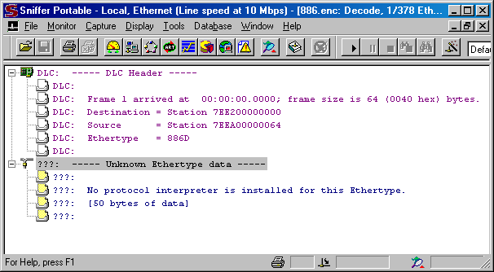
NAI Sniffer Pro v 4.70.553

Slide 5
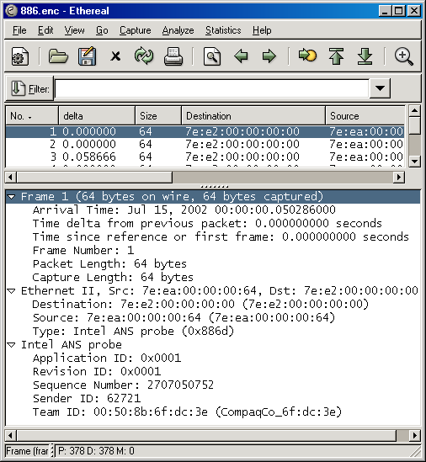
Ethereal v 0.10.5a

Slide 6
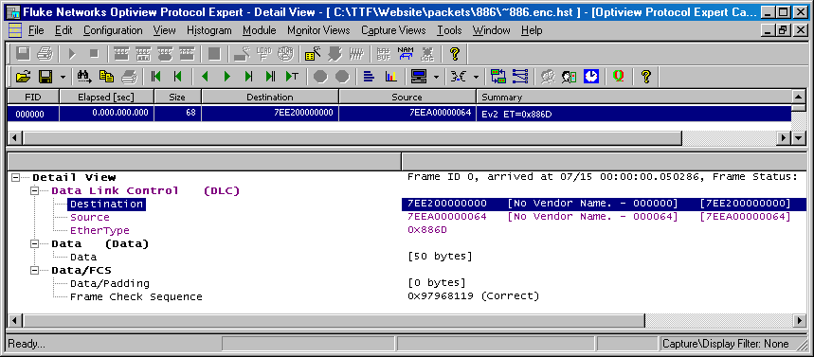
Fluke Optiview Protocol Expert v 6.1.0.13167.0

Slide 7
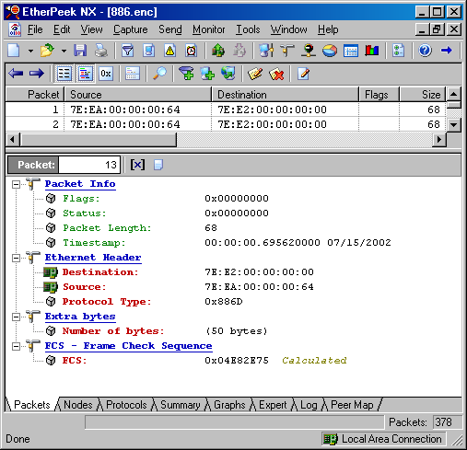
Wildpackets Etherpeek NX v 3.0.1

